Slide 1
Building a Virtual Machine with SharePoint Server 2010

Slide 2
Agenda
Verify Hardware Requirements
Install Windows Server 2008 R2
Configure Active Directory
Install SQL Server 2008
Install SharePoint Server 2010
Configure SharePoint Server 2010
Creating a new Web Application
Install Microsoft Office 2010
Install Visual Studio 2010

Slide 3
Verify Hardware Requirements
Host computer has Windows Server 2008 R2 x64
Host computer has 6GB of RAM (8GB rec’d)
Host computer has at least 80GB of free space
Host computer supports virtualization
Host computer has Hyper-V Services enabled
If you need more information on how to install and configure Hyper-V
http://www.microsoft.com/windowsserver2008/virtualization/install.mspx

Slide 4
Install Windows Server 2008 R2
Install Windows Server 2008 R2 base OS
Install Full version and not Server Core
Optionally use Microsoft trial VM with OS installed
http://www.microsoft.com/downloads/details.aspx?FamilyId= 9040a4be-c3cf-44a5-9052-a70314452305&displaylang=en

Slide 5
Configure Windows Server 2008 R2
Configure Administrator password to not expire
Change Server name
Disable Windows Firewall
Disable Enhanced Security Configuration
Enable Windows Features for Desktop Experience
Enable PowerShell Integrated scripting environ
Configure the DisableLoopbackCheck in registry

Slide 6
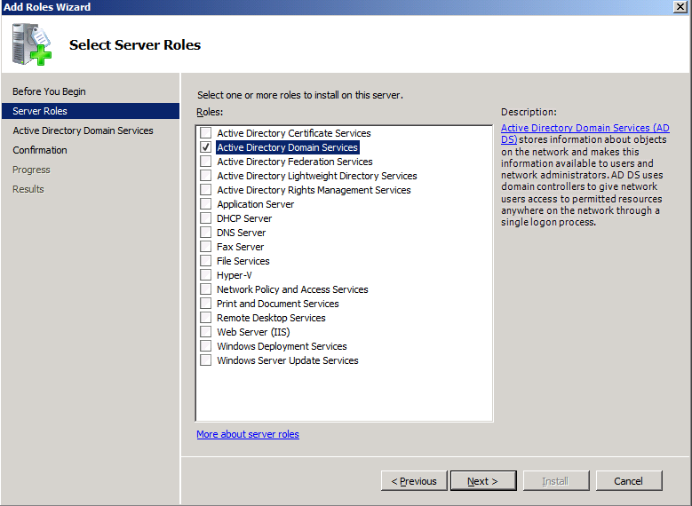
Configure Active Directory
You want you VM to live inside a domain
You must promote the VM to be domain controller
Start by installing Active Directory Domain Services
Run dcpromo.exe

Slide 7
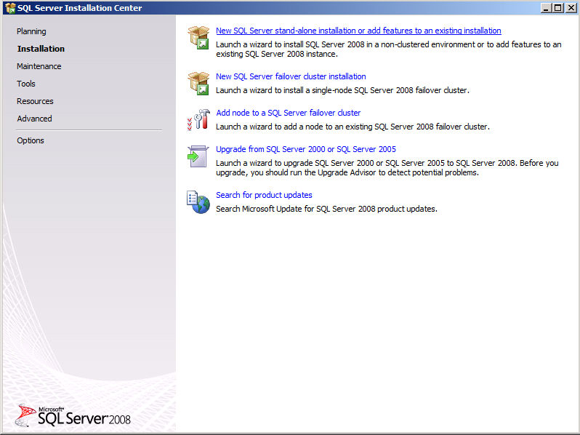
Installing SQL Server 2008
Which version?
SQL Server 2008 is OK – install SP1 and SP1 CU2
SQL Server 2008 R2 is better (install latest beta)

Slide 8
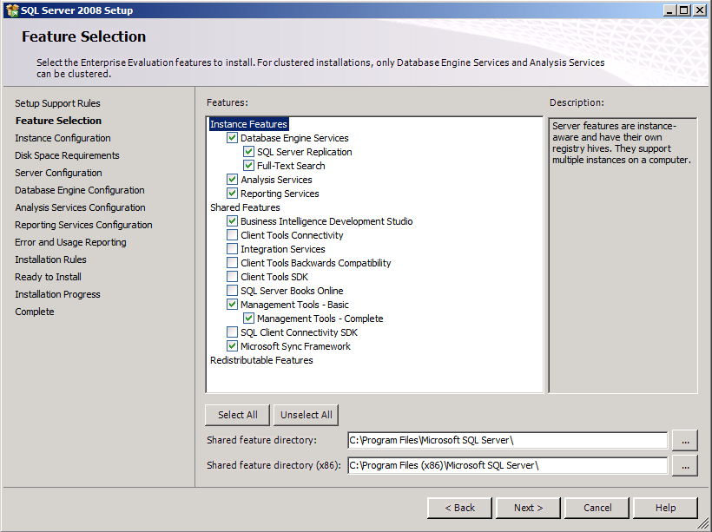
Selecting SQL Server 2008 Features

Slide 9
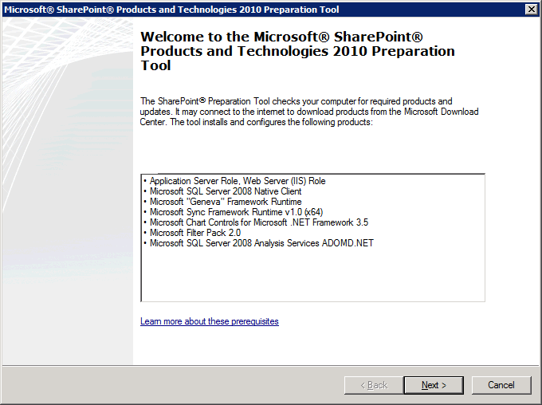
Before Installing SharePoint Server 2010
Install Windows Server 2008 R2 Hot fix for WCF
Install ADO.NET Data Services version 1.5 CTP2
Create AD account for SP Worker Process identity
Run PrerequisiteInstaller.exe

Slide 10
Configure SharePoint Server 2010

Slide 11
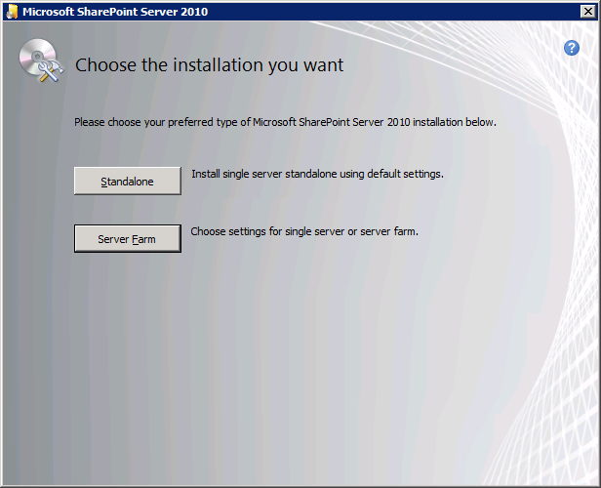
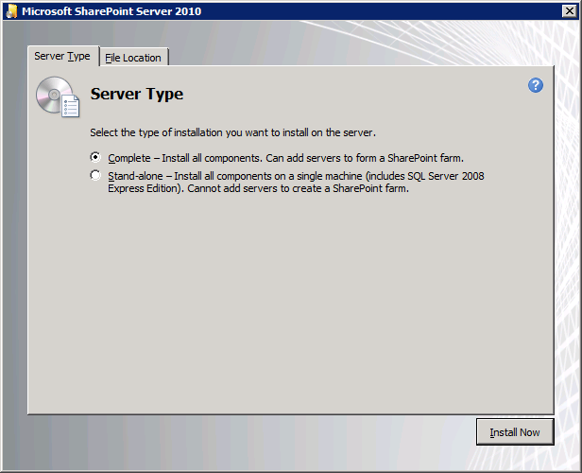
Install SharePoint Server 2010

Slide 12
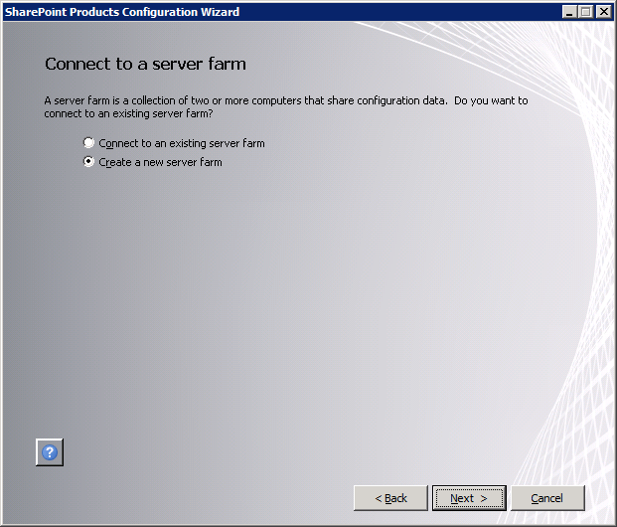
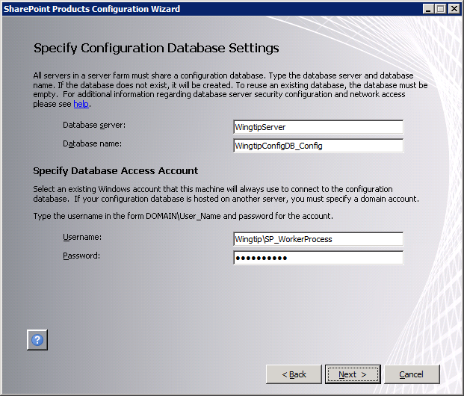
Create the Configuration DB

Slide 13
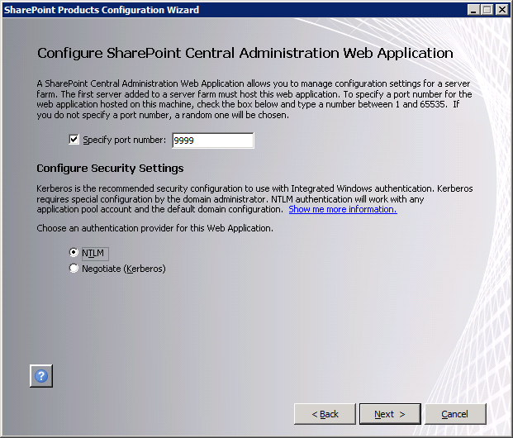
Configure Central Admin

Slide 14
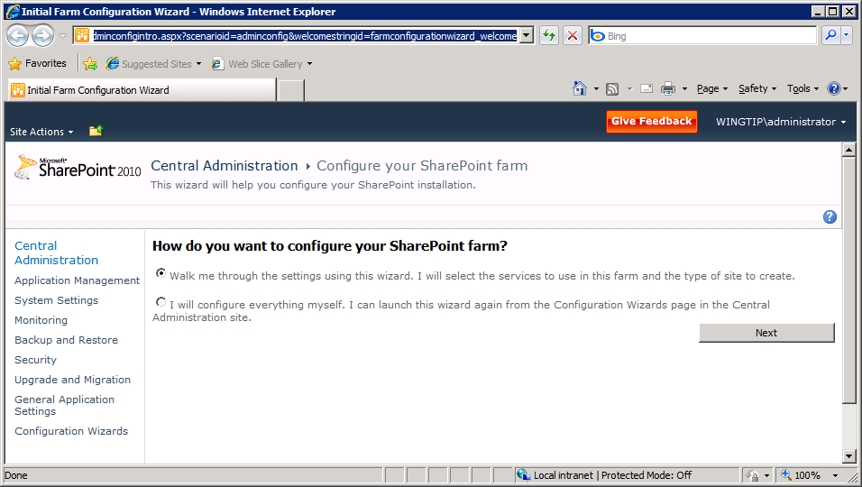
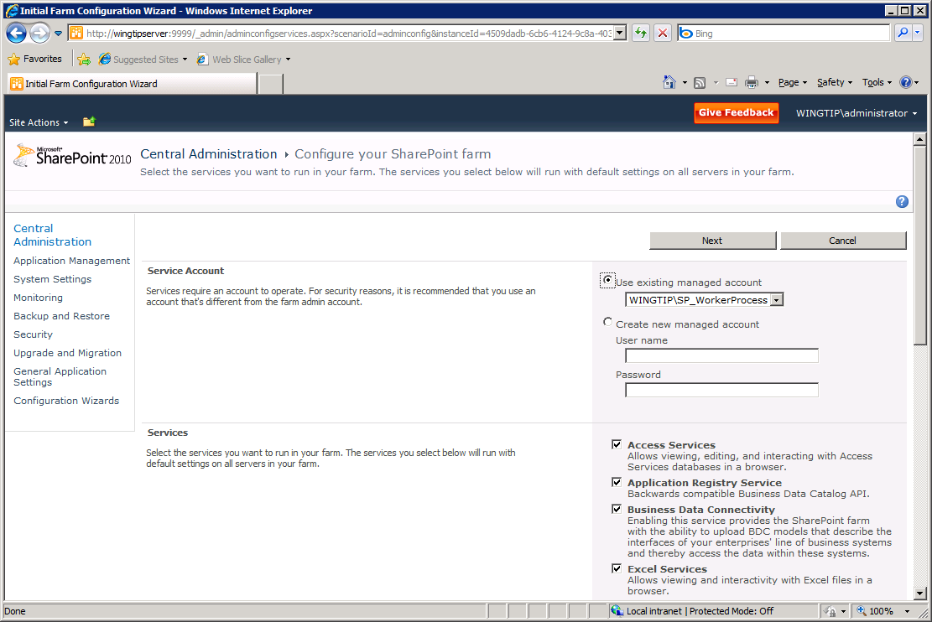
Configuring Service Applications

Slide 15
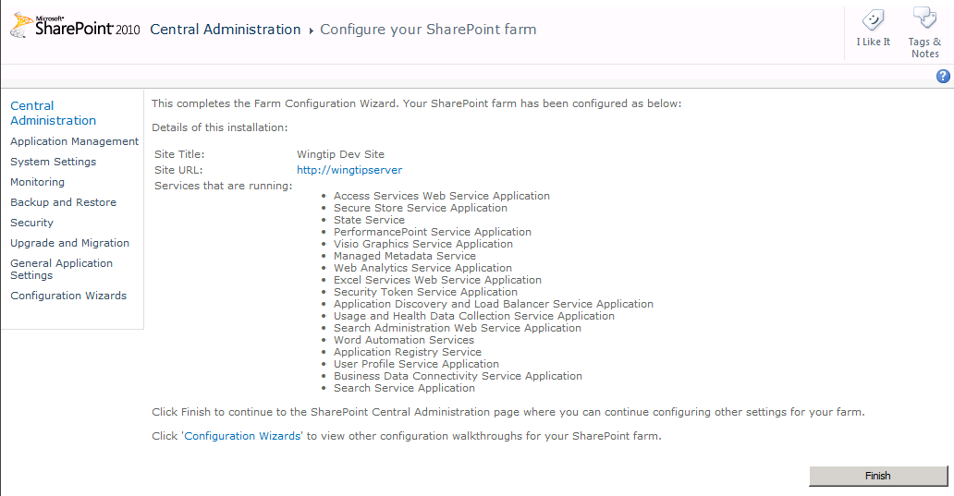
OOB Service Applications

Slide 16
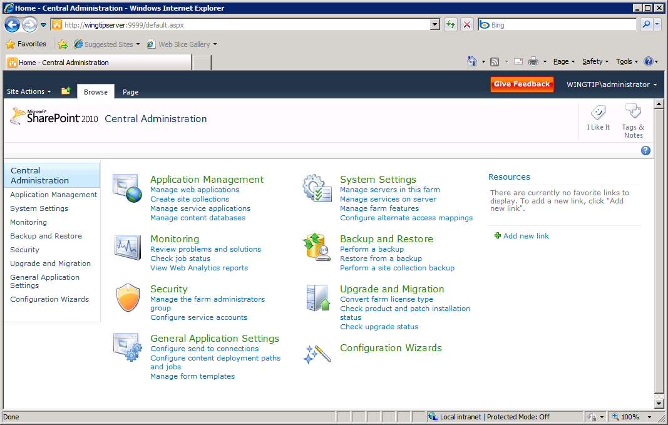
Central Administration

Slide 17
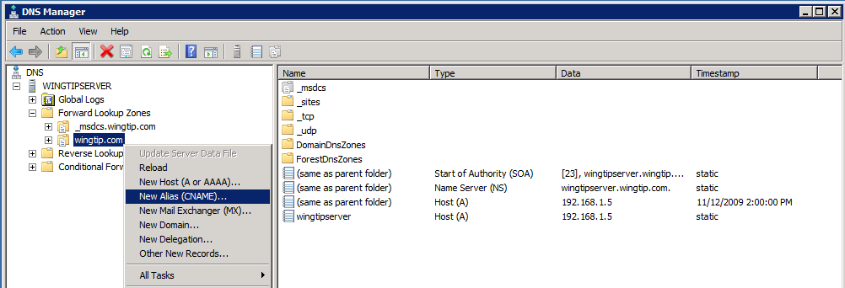
Configuring DNS for Web Applications

Slide 18
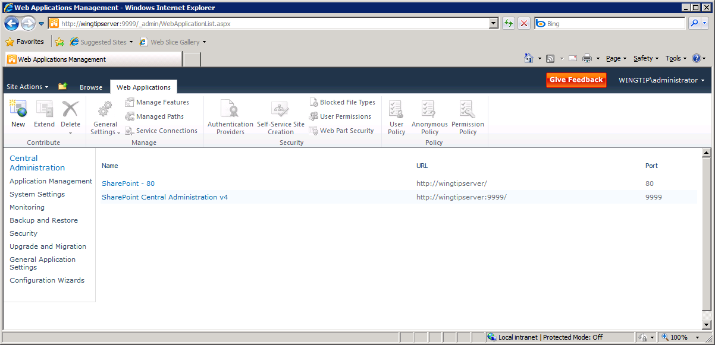
Creating a new Web Application

Slide 19
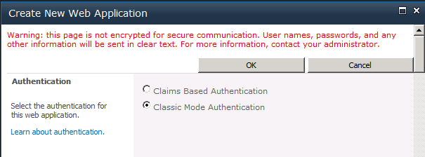
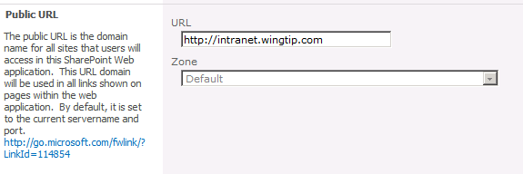
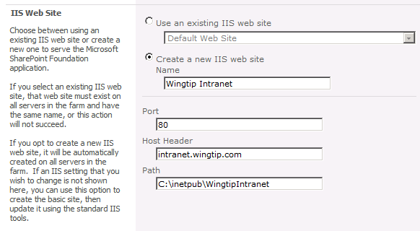
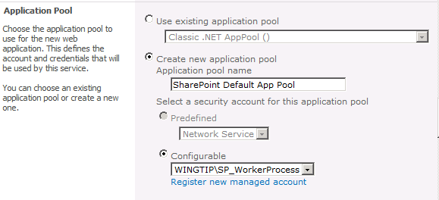
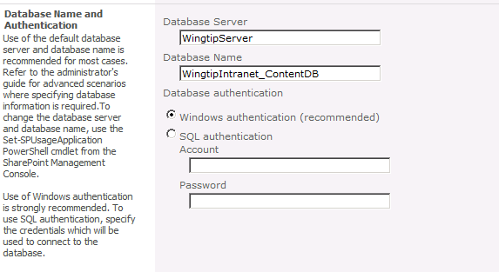
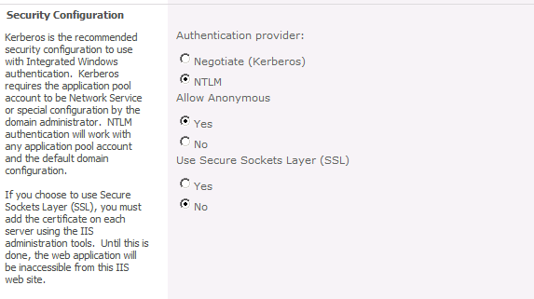
Creating a New Web Application

Slide 20
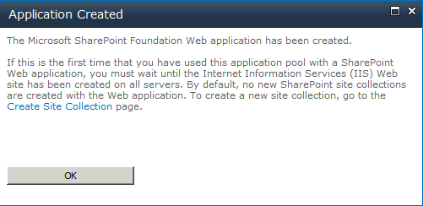
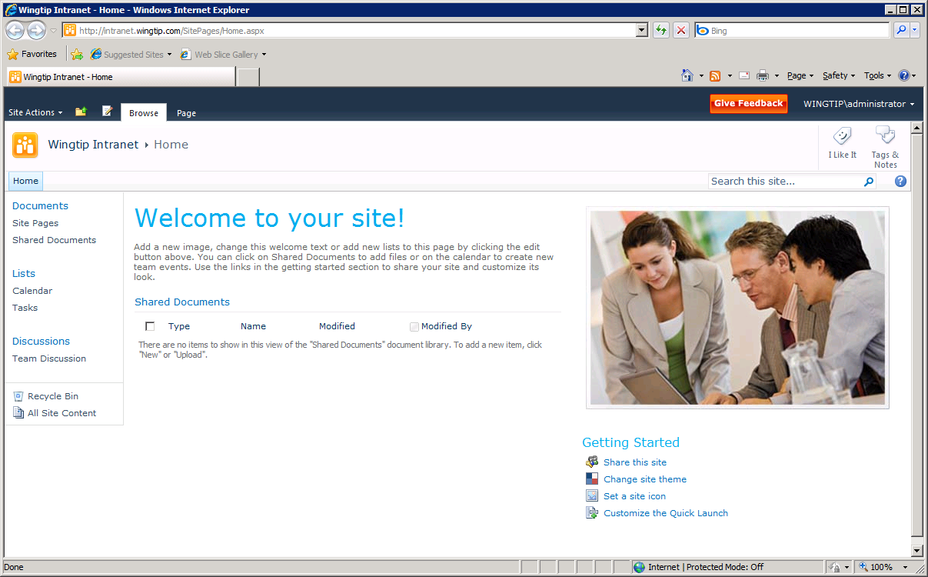
Creating Site Collections

Slide 21
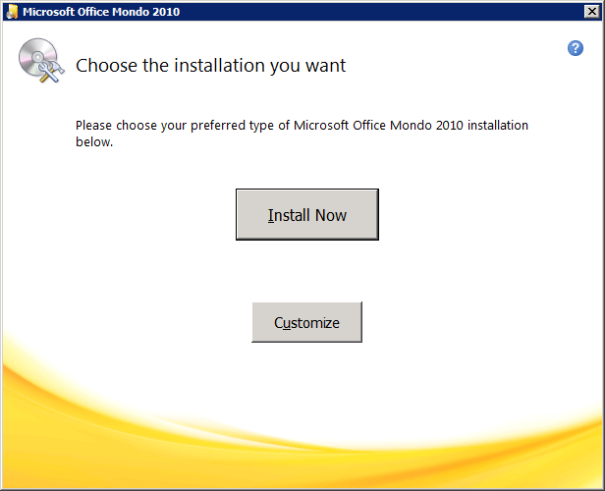
Install Microsoft Office 2010

Slide 22
Additional Office Applications to Install
SharePoint Designer 2010
Microsoft Office Visio 2010

Slide 23
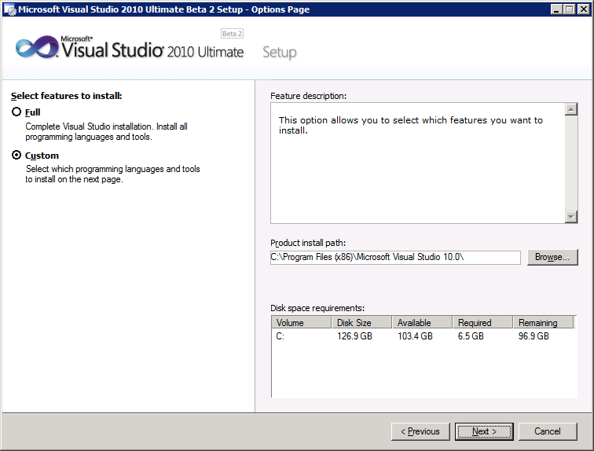
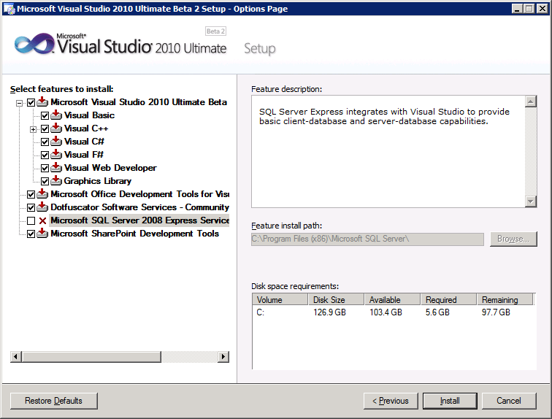
Install Visual Studio 2010

Slide 24
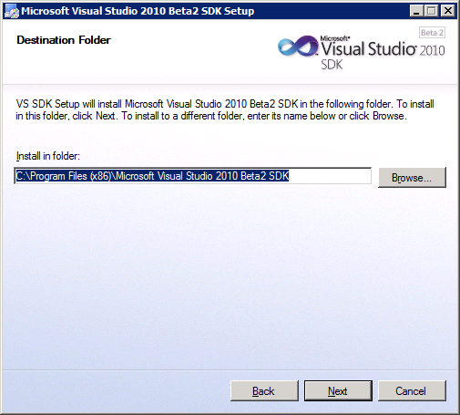
Install Visual Studio 2010 SDK
Used to create SharePoint Tool Extensions

Slide 25
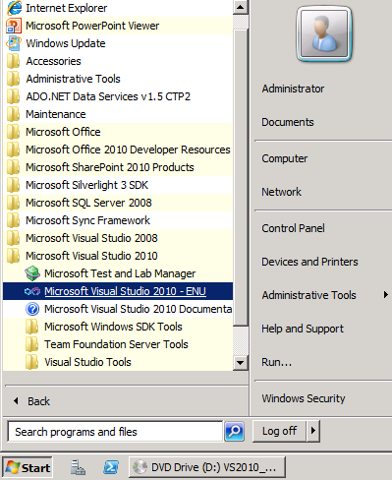
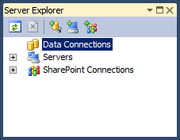
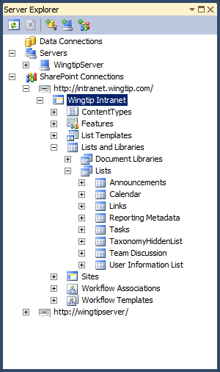
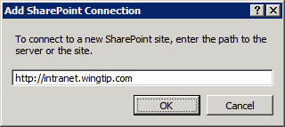
Test Visual Studio 2010
Launch Visual Studio 2010
Find the SharePoint Explorer
Add a new connection
Verify the connection displays site information

Slide 26
Summary
Verify Hardware Requirements
Install Windows Server 2008 R2
Configure Active Directory
Install SQL Server 2008
Install SharePoint Server 2010
Configure SharePoint Server 2010
Creating a new Web Application
Install Microsoft Office 2010
Install Visual Studio 2010

